Slide 1
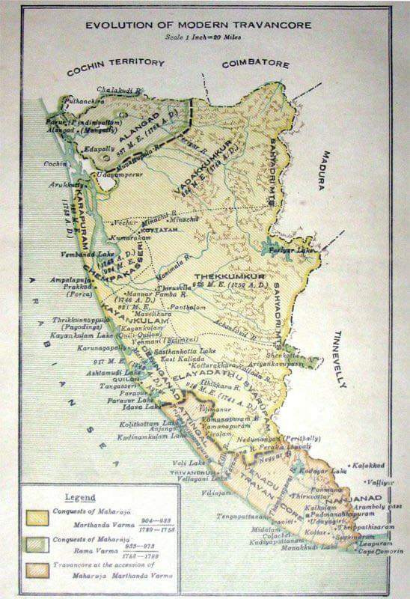
ORIGIN AND RISE OF THE TRAVANCORE DYNASTY
From Venad Kingdom to a Powerful South Indian State
Presented By:
Akash Purohit
Arya Wankhade

Slide 2
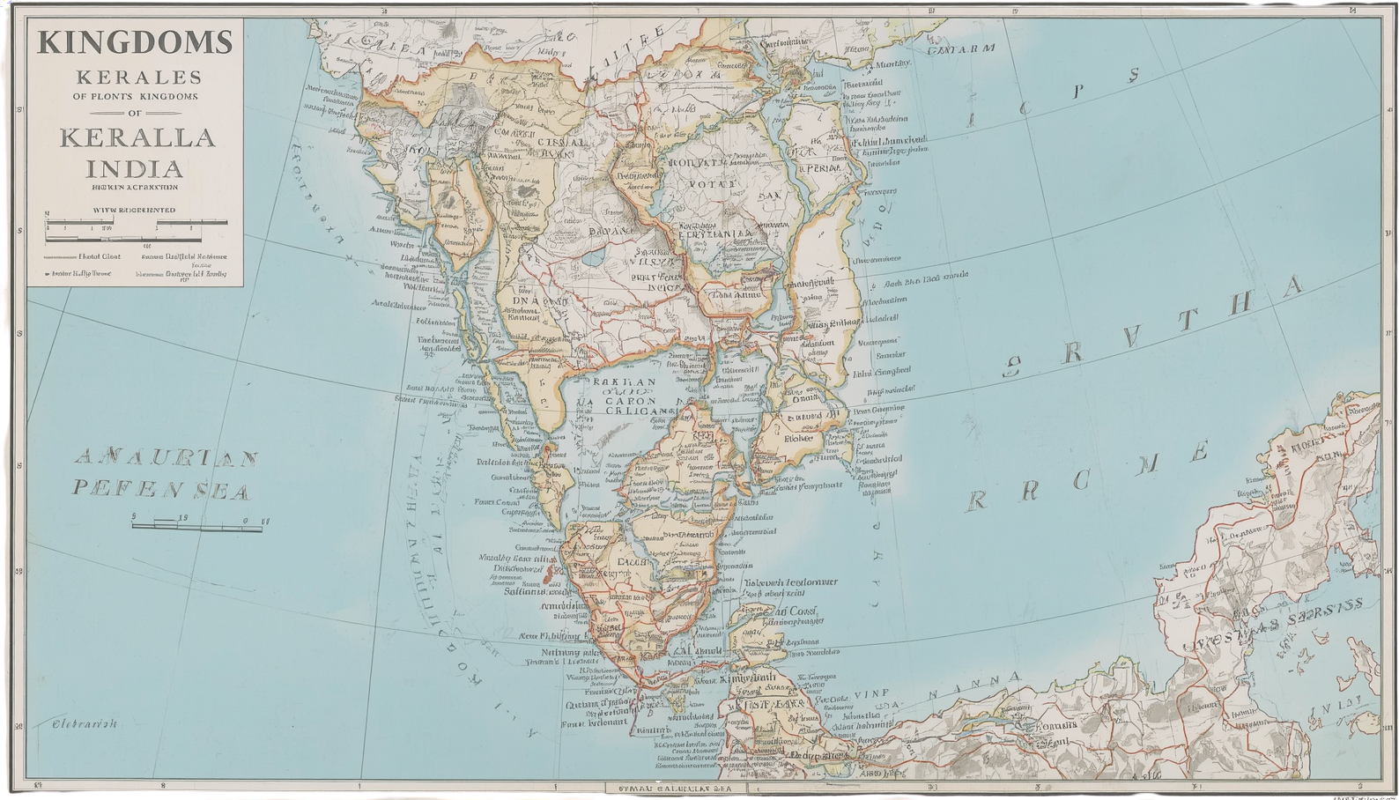
ORIGINS AND EARLY HISTORY
• Originated from the Venad royal family in southern Kerala
• Venad was a small kingdom around present-day Kollam
and Thiruvananthapuram
• Kerala was divided into many small kingdoms during the
17th century
• Each kingdom fought for control over lucrative spice trade
routes
• Marthanda Varma became ruler in 1729 and strengthened
the kingdom.

Slide 3
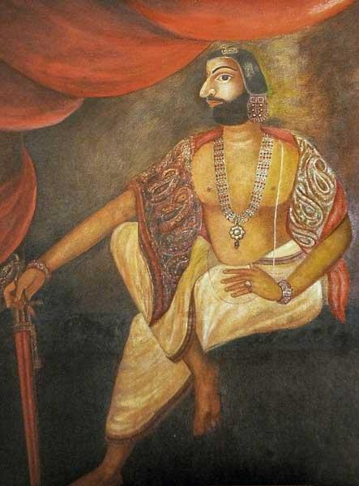
MARTHANDA VARMA'S KEY ACHIEVEMENTS
• Defeated the powerful Ettuveettil Pillamar (Eight Noble Houses)
• Established centralized administration under the monarchy
• Transformed small Venad into the mighty Travancore Kingdom
• Used strategic military conquests and diplomatic maneuvers
• Built a formidable military force
• Implemented effective governance systems for lasting stability

Slide 4
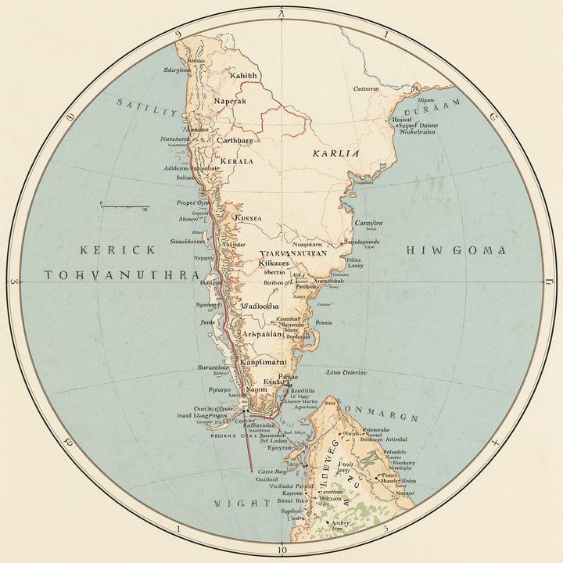
TERRITORY AND EXPANSION
• Largest kingdom in southern Kerala
• Included Thiruvananthapuram, Kollam, Alappuzha,
Pathanamthitta, and Kottayam
• Extended south to Kanyakumari in Tamil Nadu
• Northern border reached parts of Ernakulam region
• Built a formidable military force
• Implemented effective governance systems for lasting
stability

Slide 5
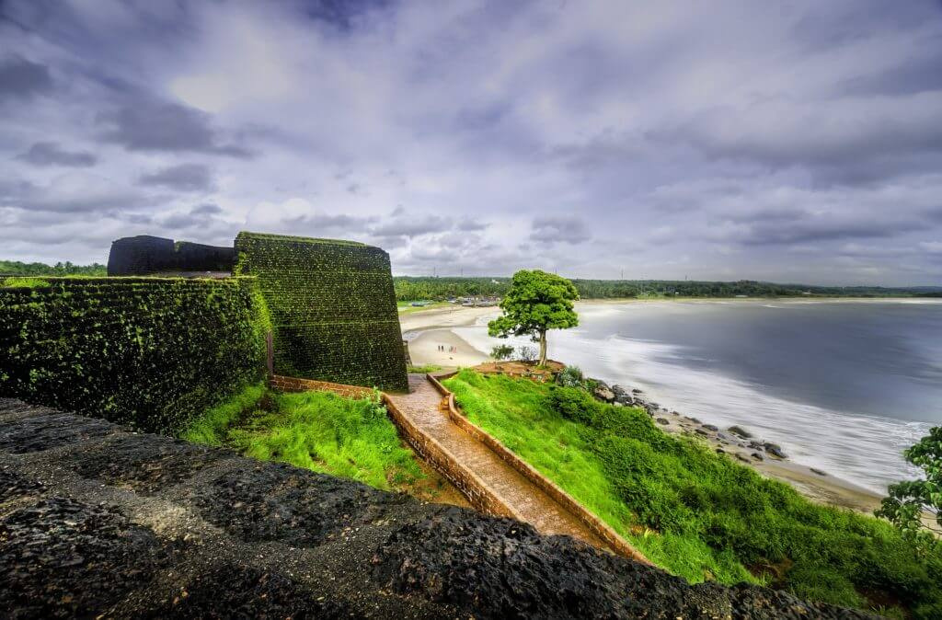
MILITARY POWER AND WARS
• Battle of Colachel (1741) – defeated the Dutch
East India Company
• One of the earliest Asian victories over a
European colonial force
• Dutch commander De Lannoy joined
Travancore army
• Army modernized using European military
techniques
• Built Nedumkotta fortification against Mysore
invasions
• Successfully defended against Tipu Sultan's
attacks

Slide 6
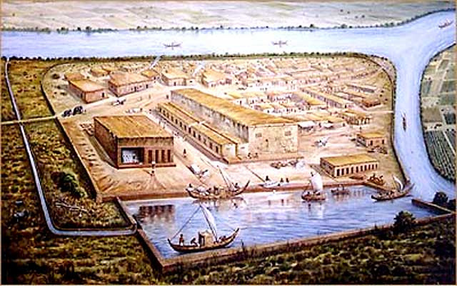
ADMINISTRATION AND ECONOMIC GROWTH
• Developed strong centralized administration
• Improved agriculture and irrigation systems
• Spice trade increased kingdom wealth significantly
• Pepper, cardamom, and cinnamon were exports
• Built extensive road networks and markets
• Developed key ports along the Arabian Sea coast
• Trade relations with Arabs and Europeans
• Kingdom became economically stable and powerful

Slide 7
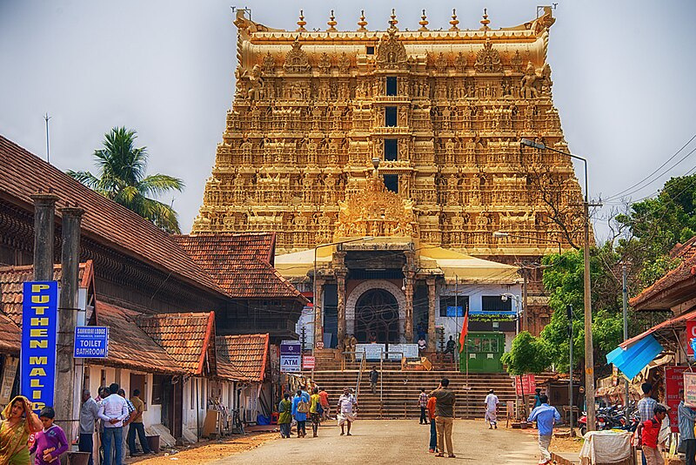
CULTURAL CONTRIBUTIONS AND ARCHITECTURE
• Built and renovated many temples across Kerala
• Sree Padmanabhaswamy Temple became the
spiritual center
• Constructed Padmanabhapuram Palace with
traditional Kerala architecture
• Built forts and defensive walls like Nedumkotta
• Supported Kathakali, literature, and classical arts
• Encouraged Sanskrit and Malayalam learning
• Improved water canals and public infrastructure

Slide 8
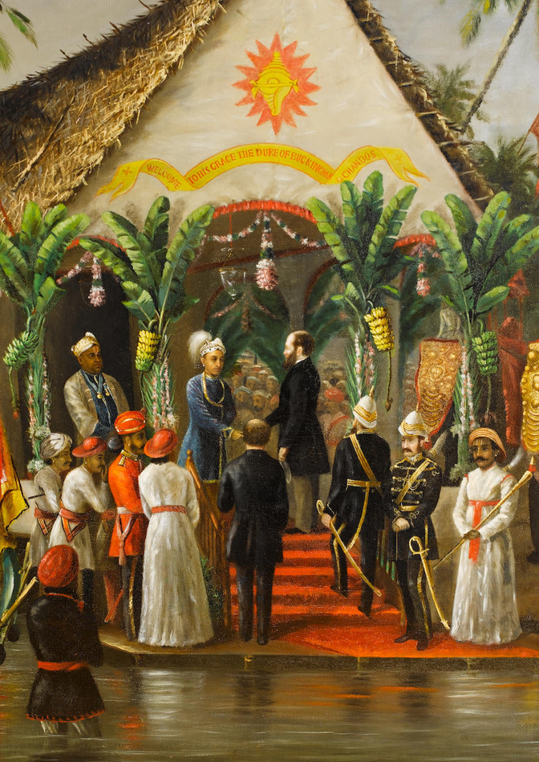
FOREIGN RELATIONS: EARLY PERIOD
• Maintained trade relations with Portuguese, Dutch, and British
• Exported spices through Arabian Sea trade routes
• Used diplomacy to avoid complete British annexation
• Dutch influence reduced after the Battle of Colachel
• British became major political allies during later years
• Signed treaties with the British East India Company
• Maintained partial independence under British protection

Slide 9
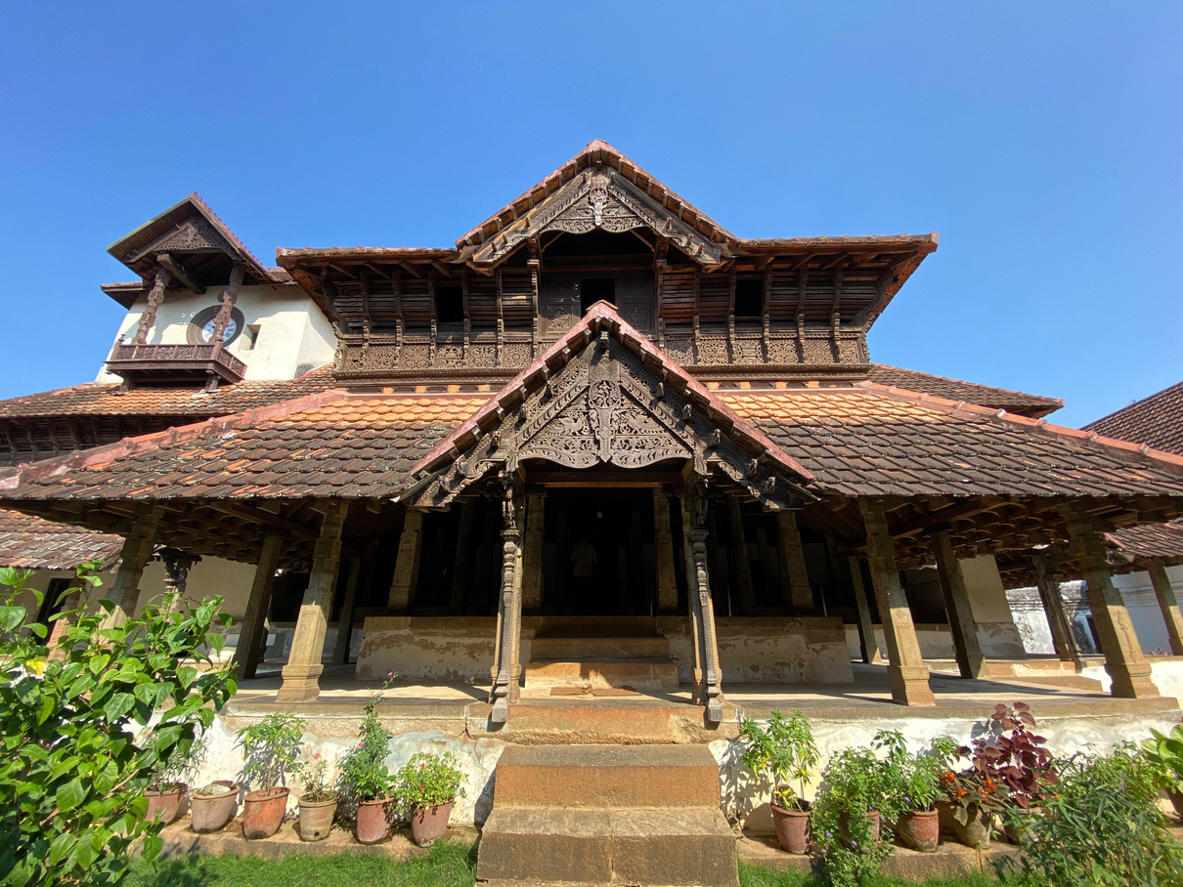
TRANSFER OF POWER AND LEGACY
• Signed Subsidiary Alliance with the British
• British troops stationed for kingdom protection
• Kingdom paid subsidies to the British government
• Became a princely state under British control
• Post 1947 : Travancore merged into modern
Kerala
• Sree Padmanabhaswamy Temple remains a
lasting symbol

Slide 10
THANK YOU

